Slide 1
Data Science Methods for Cutting Edge Research
Machine Learning Introduction and Classification

Slide 2
Motivation
You are have access to the following dataset. Visually you can see distinct groupings or categories of elements.
How would you use this information to make predictions about the classification of other elements?
Notes:
A large class of machine learning can be reduced to this format of question: given a set of inputs and a set of related outputs, can I say something about their relationship?
Here, you may say, well that doesn’t seem that hard or new or complicated.
But it is! And it can get harder when you have multi-dimensional inputs and outputs. Here, we’re only using two.
Machine learning always intimidated me, but eventually you realize it’s just fancy stats mixed with computer science.

Slide 3
Outline
Overview of key terms/vocab in ML
Types of learning / modeling
Different models, different purpose(s)
Types of data
Evaluating your models
Classification methods
KNN + Python practice
Logistic regression
Figures and notation will follow Introduction to Statistical Learning unless otherwise noted; see the syllabus for a free PDF of the book.
Notes:
Today, we want to go over a broad overview of machine learning topics, and get you started on your very first machine learning algorithm called K-nearest neighbors.
Exciting!

Slide 4
Concepts: Types of learning and purpose of learning (basic terminology)
Differentiating “statistical learning” vs “machine learning”
Differentiating “supervised” vs “unsupervised”
Differentiating “prediction” vs “inference”

Slide 5
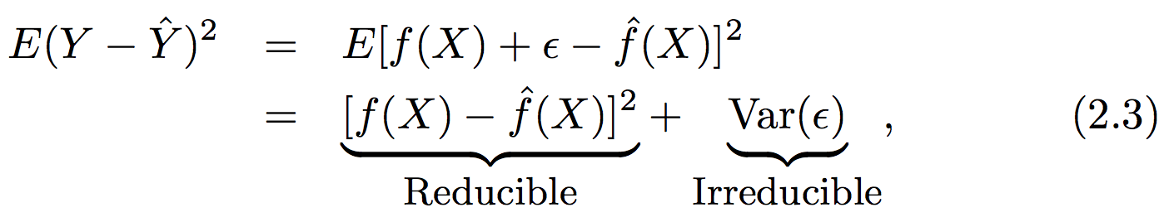
Basic terminology: Supervised versus unsupervised
Supervised methods assume there is a functional form that can describe our output vector (Y) given some input vector (X)
We are concerned with estimating a function that can predict an output given a certain set of inputs
There are two limits to the error in our function
“E()” is the expectation value or average squared error
Notes:
In machine learning, there are a many different methods depending on the type of data you have and the type of problem you want to solve with that data. There is no one-size-fits-all approach.
In supervised learning, we are trying to find some function that related a set of inputs to a set of outputs.
There can be multiple inputs. There can be multiple outputs.
Unfortunately, you can never get a perfect fit, because of error. Error can be reducible (if there are inputs you just aren’t accounting for) or irreducible (due to random noise).
We measure the goodness of fit using the squared error.

Slide 6
Basic terminology: parametric versus non-parametric
Some models have a defined functional form over the entire range of input values (parametric modeling)
We assume a functional form (parameters or coefficients)
We determine the parameters by minimizing the error between the model and reality for some subset of our data (fitting or training)
Some models do not assume a defined functional form – the goal is just to get as close as possible to the data (non-parametric modeling)
There is still a model fitting procedure; the model still has some information content that is determined from your data
In parametric modeling you risk overfitting especially with noisy data. In non-parametric models you require much larger training data sets

Slide 7
Basic terminology: regression versus classification
In supervised learning, some models deal with the prediction of a numerical output given some inputs: regression problems
See if you can come up w/an example of where regression would be useful in materials / energy science
On the other hand, some models deal with the prediction of whether some object (defined by X) is a member of a certain group (or class): classification problems
See if you can come up w/an example of where classification would be useful in a problem related to social science
Some methods (e.g., KNN) can be used for regression purposes and classification purposes! Weird!

Slide 8
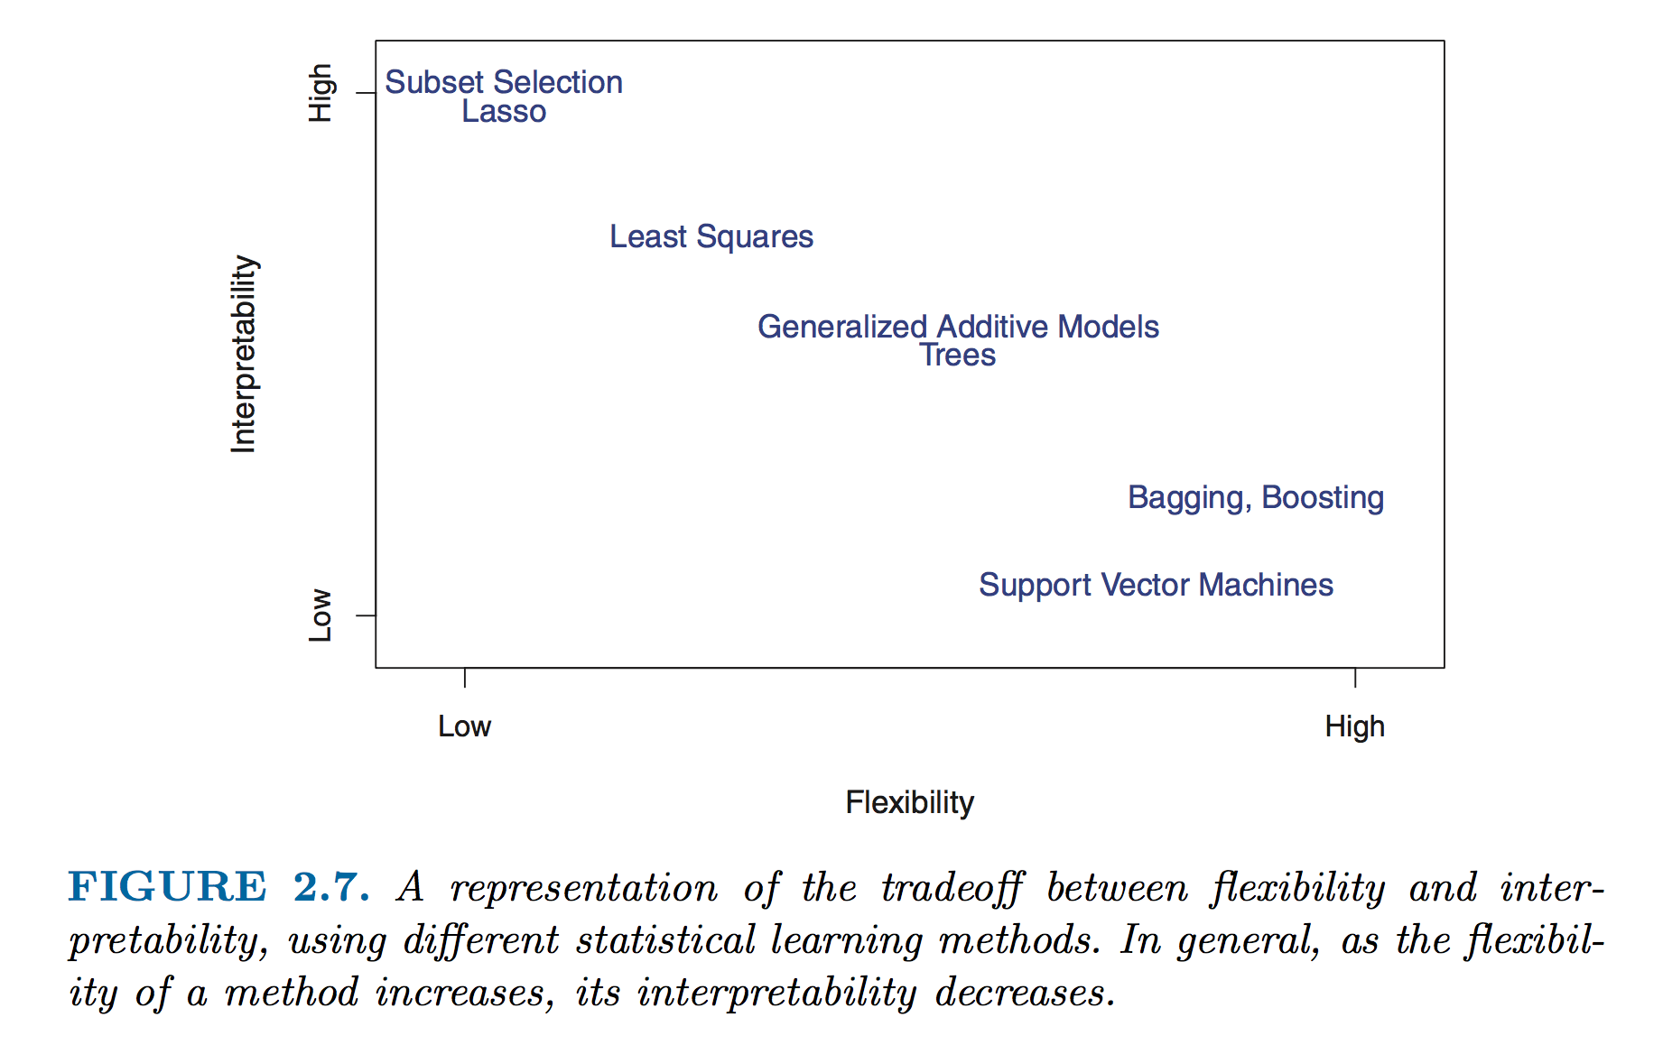
Basic concepts: Flexibility and interpretability
Notes:
Two basic ideals you are trying to achieve when making a model.
Parametric models typically are more interpretable, but aren’t as flexible.
Non-parametric models are more flexible, but less interpretable.
Why would you want a more flexible model? A more interpretable model?
Prediction: Given a new set of data, would we be able to use our model to predict outputs?. F(x) is a black box.
Inference: How do our inputs relate to our outputs? Interested in f(x)

Slide 9
Data: Training and Testing
Supervised learning problems always require a set of data that must be used to train your model
Remember: model training means we are finding the minimum error between our predicted outputs and measured outputs (Ŷ vs Y)
We always want to know how our model is doing “out in the real world” on some test data that the training process was blind to (validation)
Notes:
Key difference in approaches between simple regression used to describe trends
and machine learning that seeks to make use of models beyond the data on which it was modelled.

Slide 10
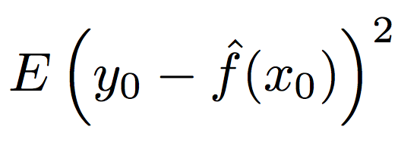
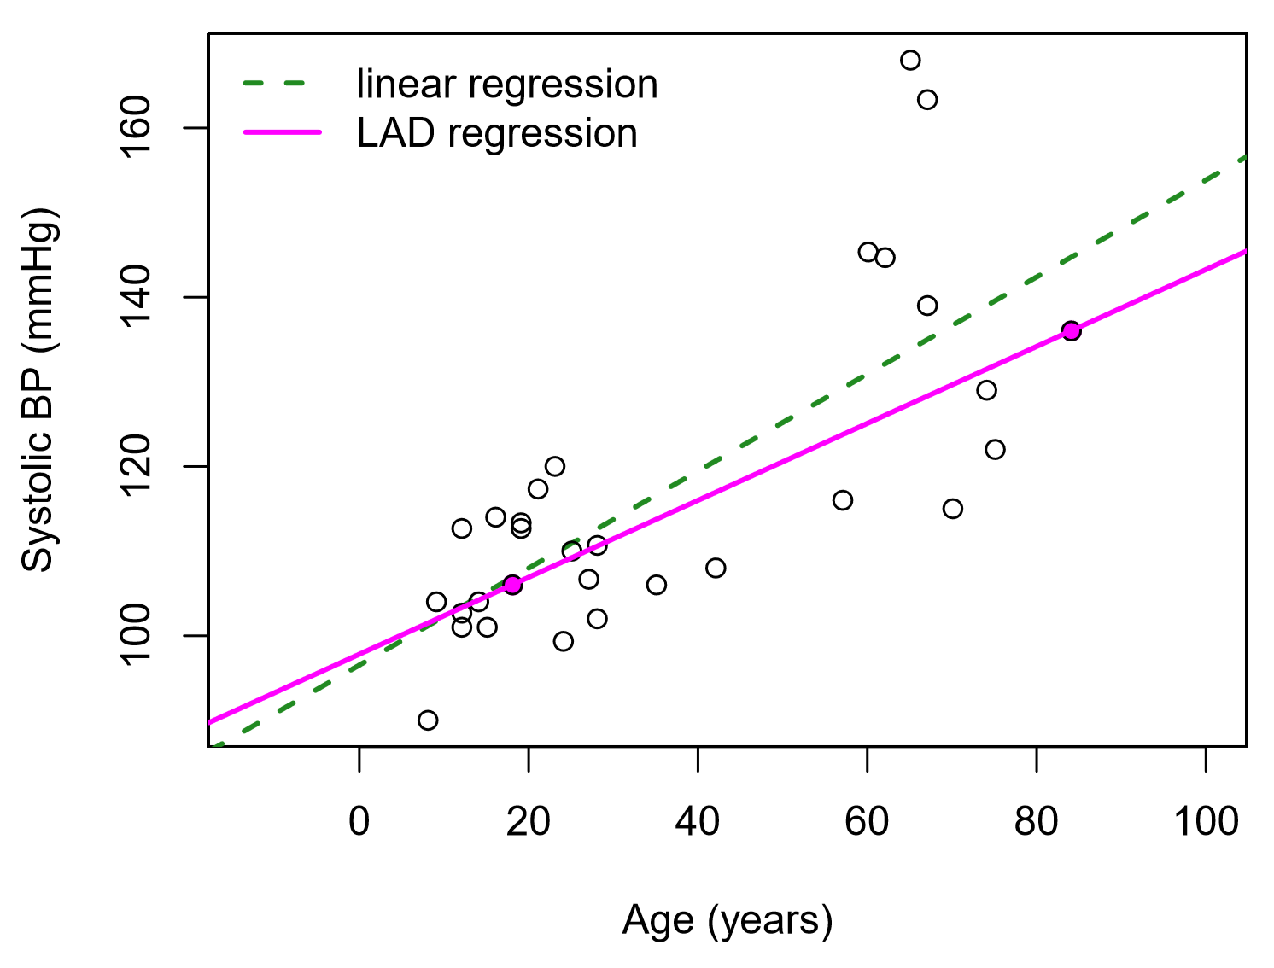
Assessment: Measuring model accuracy (regression)
The MSE as an estimator
Challenges with the MSE and why we need other estimators
Side conversation: Why is it squared error?
Does anyone know why we can’t use the MSE in classification problems?

Slide 11
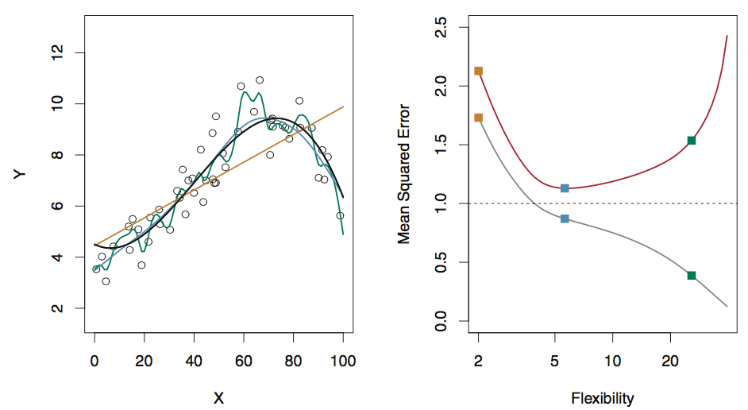
Assessment: Flexibility and overfitting
The true functional form is given w/the black curve
Compare errors in the training data from three test functions (orange, green, blue) [grey curve, right]
Compare errors in the testing data from the three test functions [red curve, right]
With four parameters I can fit an elephant and with five I can make him wiggle his trunk.
John von Neumann
Fig 2.9, ISL

Slide 12
Assessment: Bias and variance
Ultimately we care about the true expectation value of the error of our model (given infinite testing data)
The variance in our model shows us how much the error changes if we estimated f with a different set of training data (e.g., consider fit w/many splines)
The bias of our model shows us how much error is introduced by the simplicity of our model (e.g., curvy data w/linear fit)
The total MSE can never fall below the variance of the error!

Slide 13
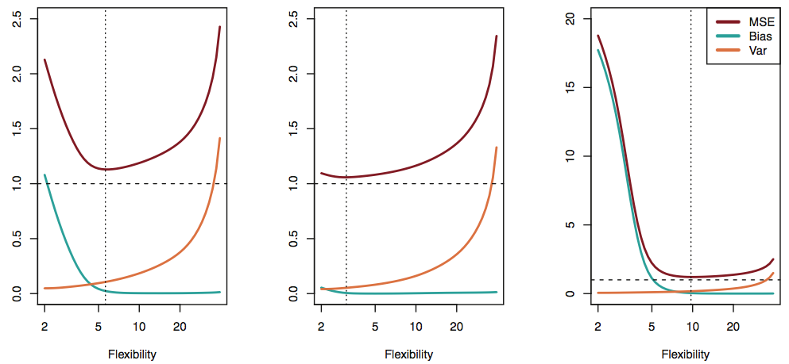
Bias and variance: the tradeoff
In practice, the bias error is difficult to estimate quantitatively, but the principle is critical to qualitatively understand!
See figs 2.9-2.11 and full version of Fig 2.12 in ISL for more examples!
Modified Fig 2.12, ISL

Slide 14
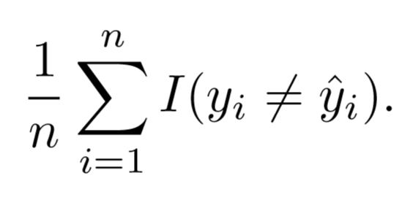
Assessment: Errors in classification problems
Even though we aren’t making a quantitative prediction, we still need to assess the model accuracy
Consider the frequency of incorrect classification, the error rate
The training error rate is the frequency of errors on our training data
Generally more interested in the test error rate, errors on data that were not used to train our classifier

Slide 15
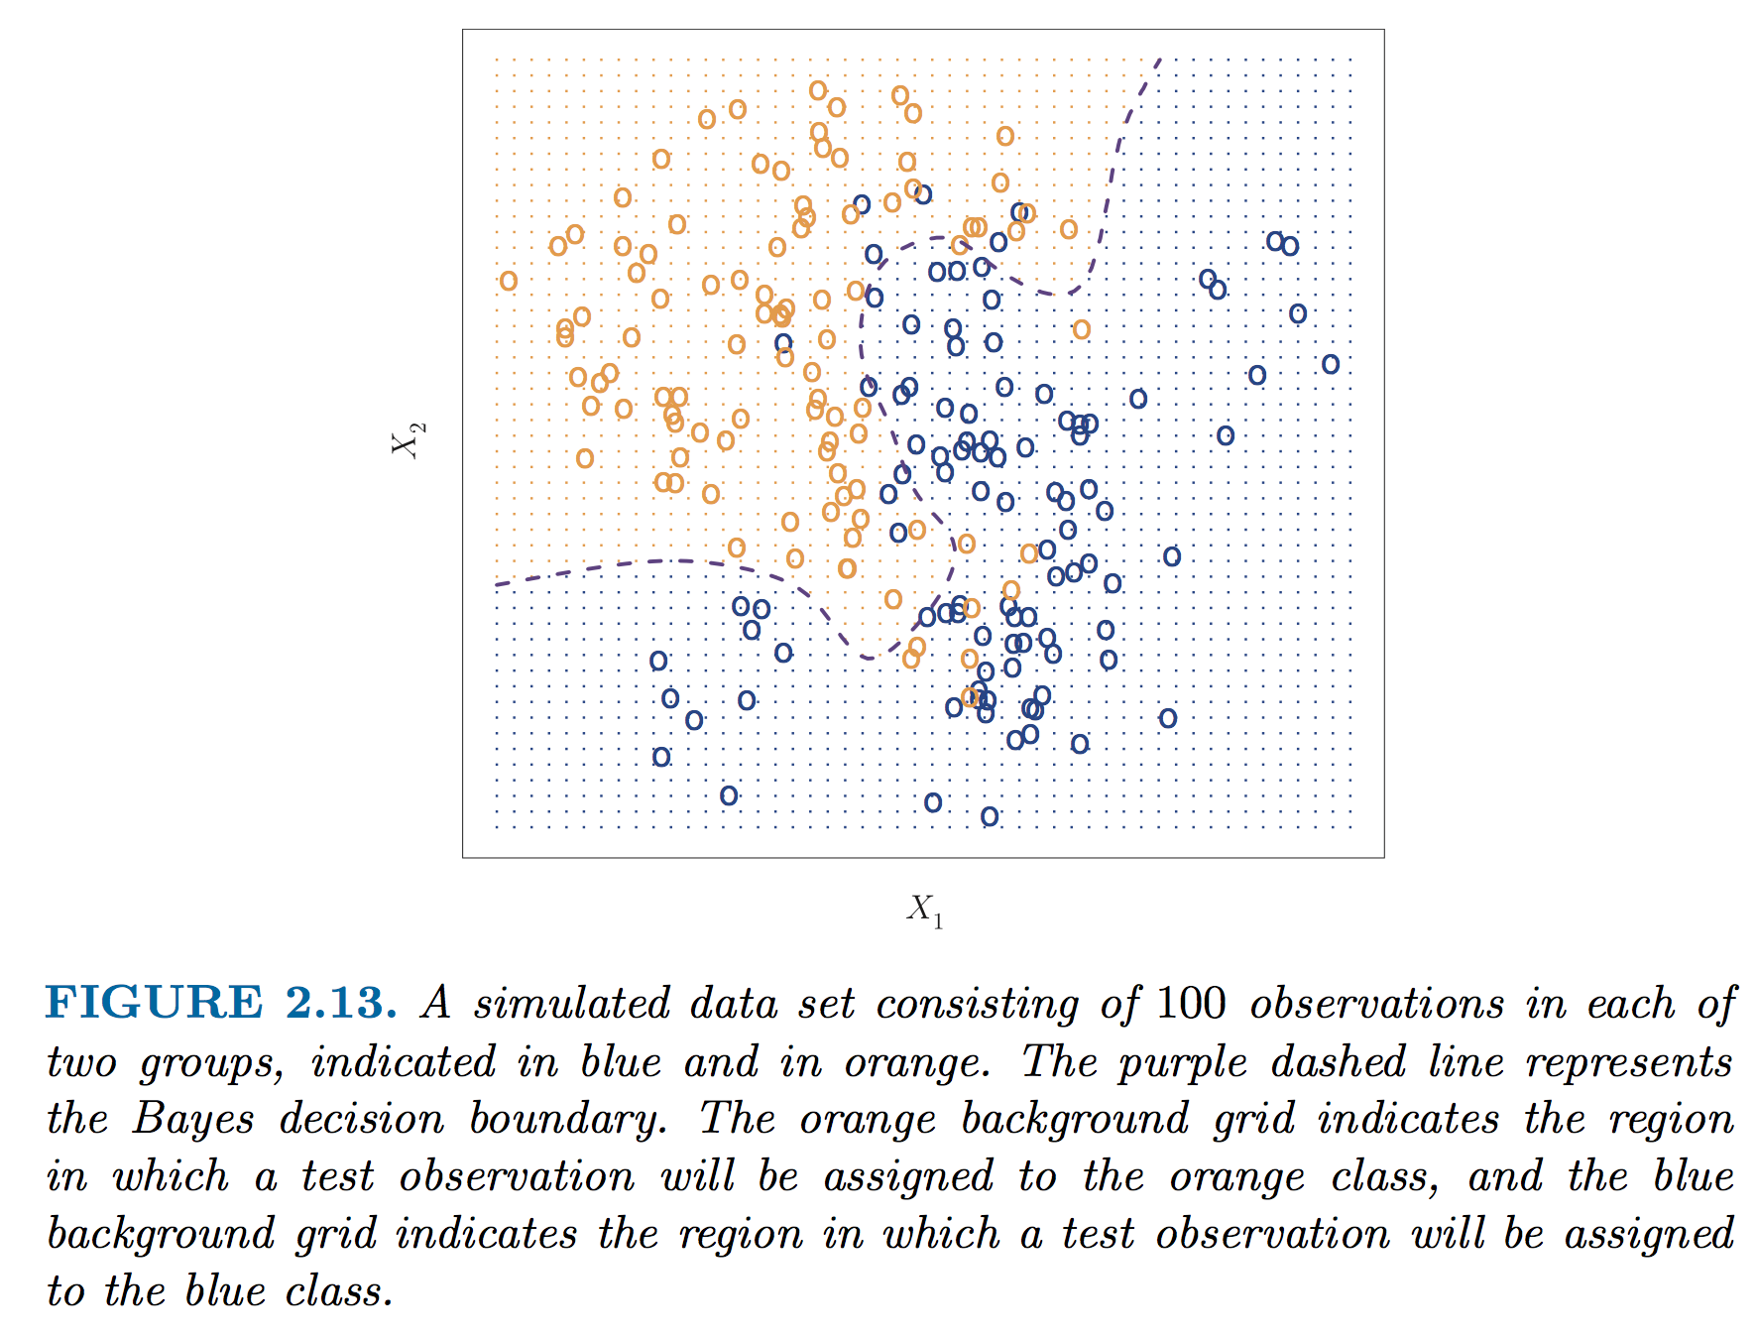
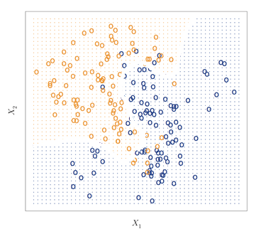
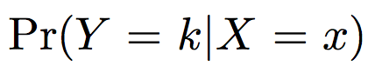
An estimator for the irreducible error in classification: Bayes classifier
In principle if we know the true conditional probability distribution for our data, we can construct a surface (a decision boundary) that guarantees our error rate in classification is minimized
This ideal model is the “Bayes classifier” and this boundary is the “Bayes decision boundary”
Notes:
In this classification problem, our inputs are quantitative values X1 and X2.
Our outputs are colors orange or blue.
How would YOU classify these? Well, you’d probably just draw a line. Something like this. But how do we formally define this line?
We do it in terms of conditional probabilities.
If you knew the probability that you’d have an orange dot at each point, you would draw the line at wherever the probability is equal to 0.5.
It gets more complicated for more dimensions, but the 2D visualization helps, right?

Slide 16
Transition from ML overview!
Any questions / concerns
If people are really bored, someone could ask me to tell a joke right now

Slide 17
Classification methods
[quick warmup?] Examples of classification problems in materials or molecular science?
We will cover two types of classification methods in this class:
k Nearest Neighbors (often KNN)
Making a map of parameter space and estimating the class membership based on locality to other members of the class
Logistic regression
Making a mathematic guess about the likelihood of class membership using a simplified mathematical model (the logistic function)

Slide 18
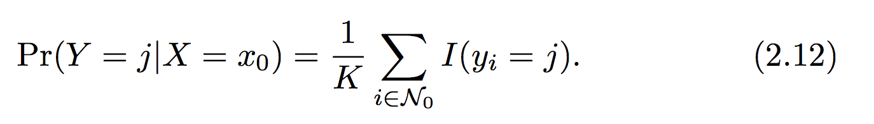
(probably) the simplest classification method is k-nearest neighbors (KNN)
The KNN classifier works on assigning the probability of membership in a class based on distance to other members in a class
Simple, right?
Our selection is based only on K – the number of neighbors we consider
What are the possible ranges of K?
The KNN classifier

Slide 19
A note about distances and identifying who is “nearest” ?
In this example, and all others we looked at and discussed you all made a key assumption (without realizing it) when you were identifying neighbors
The data in each dimension of X should be scaled similarly!
We are concerned with relative distances in the parameter space, not absolute distances in the underlying units
Otherwise units, dimensionality, etc. can drastically favor closeness in arbitrary dimensions of X

Slide 20
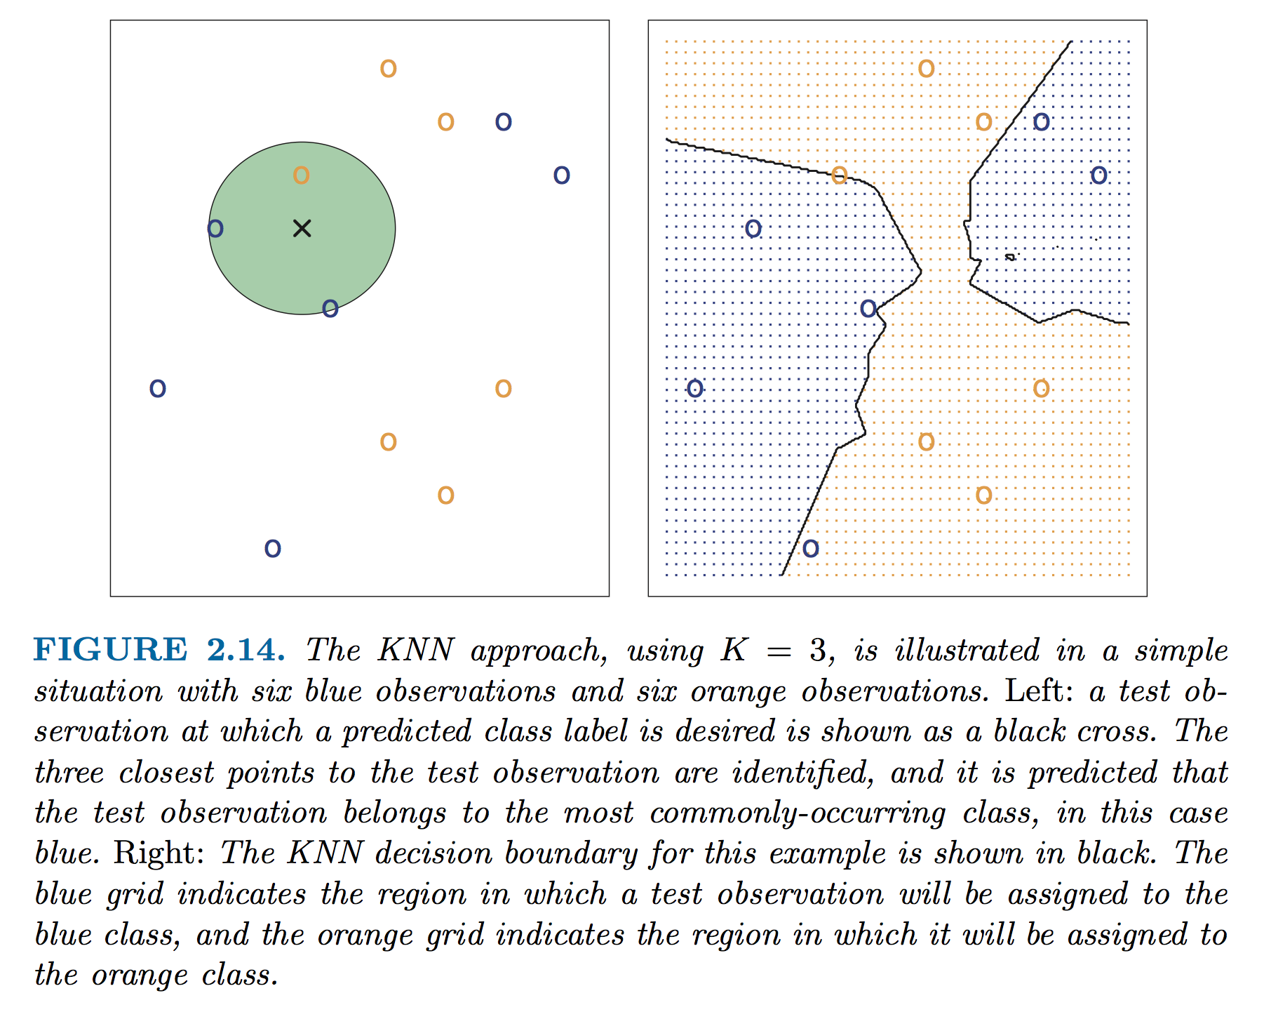
Illustration of KNN

Slide 21
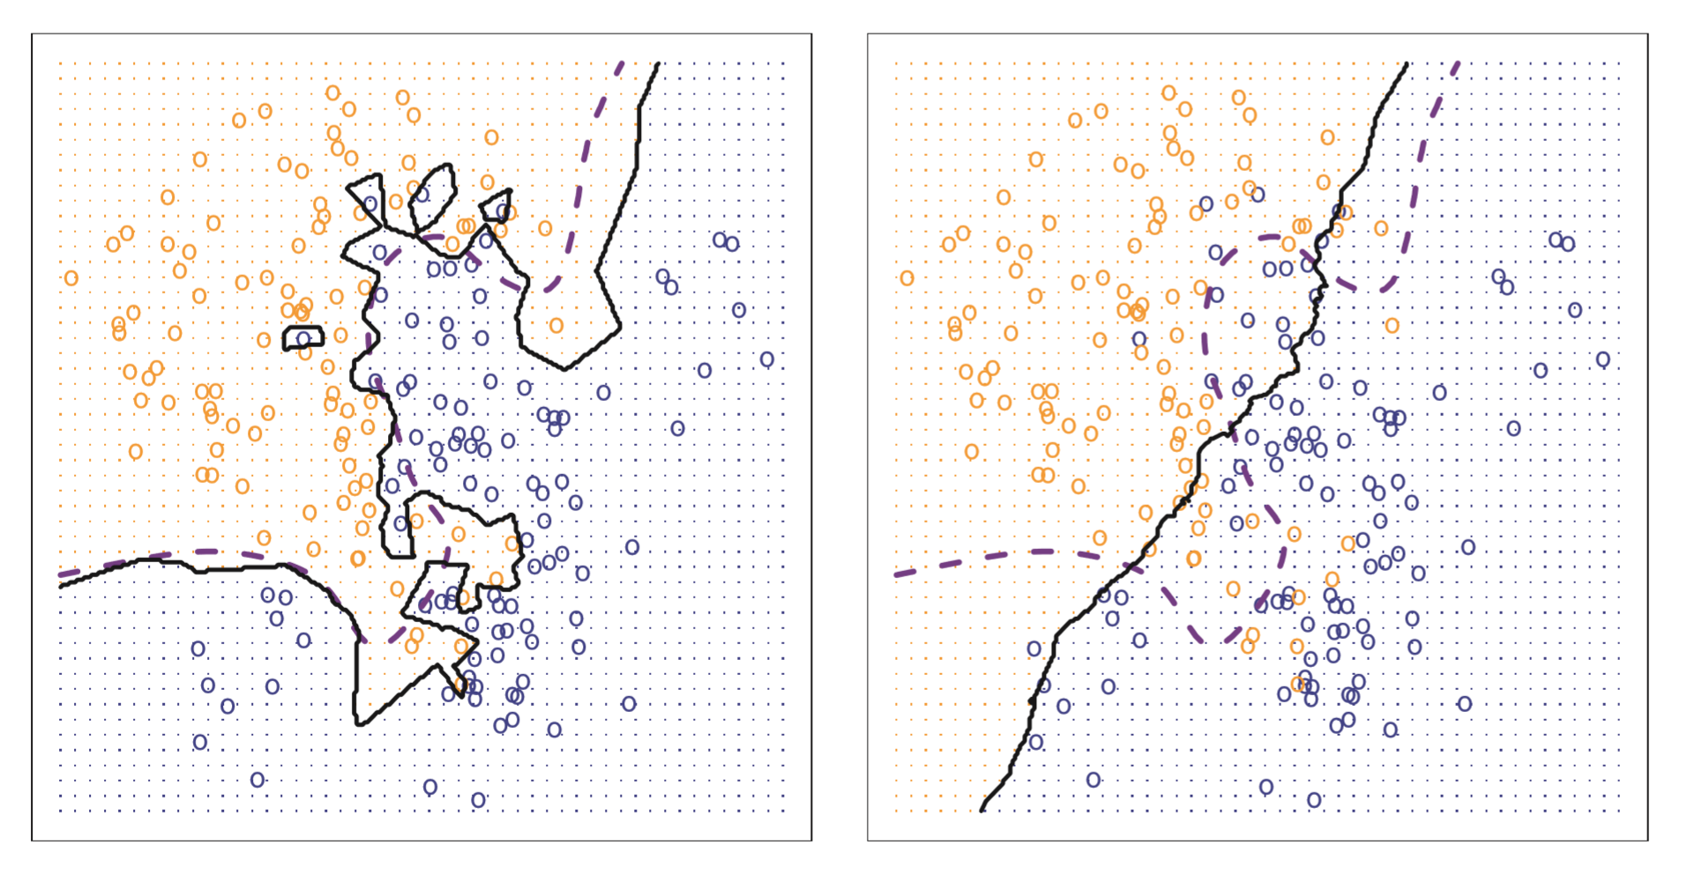
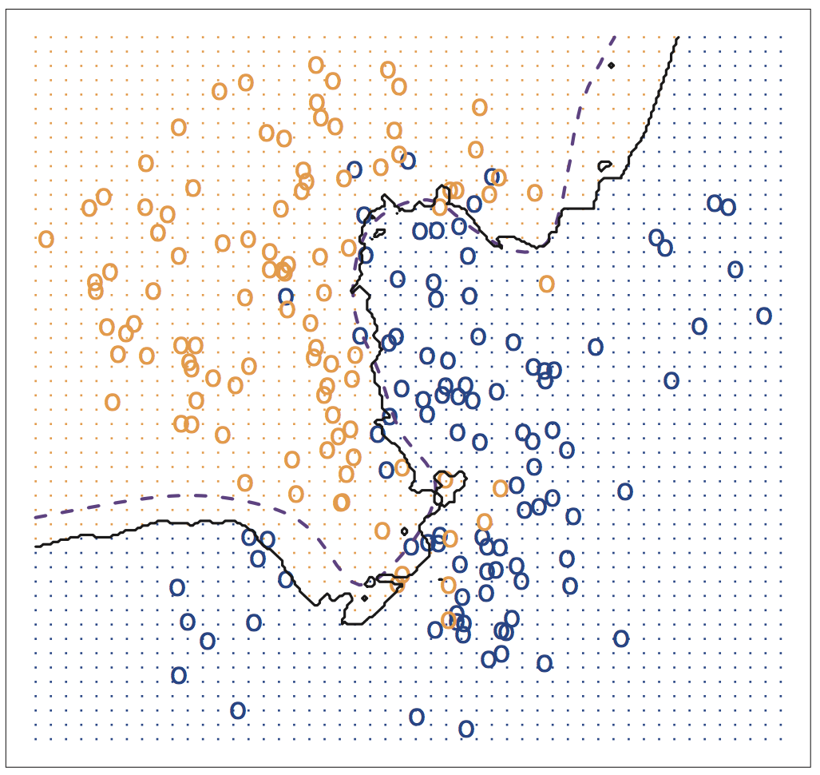
Effect of K on boundary

Slide 22
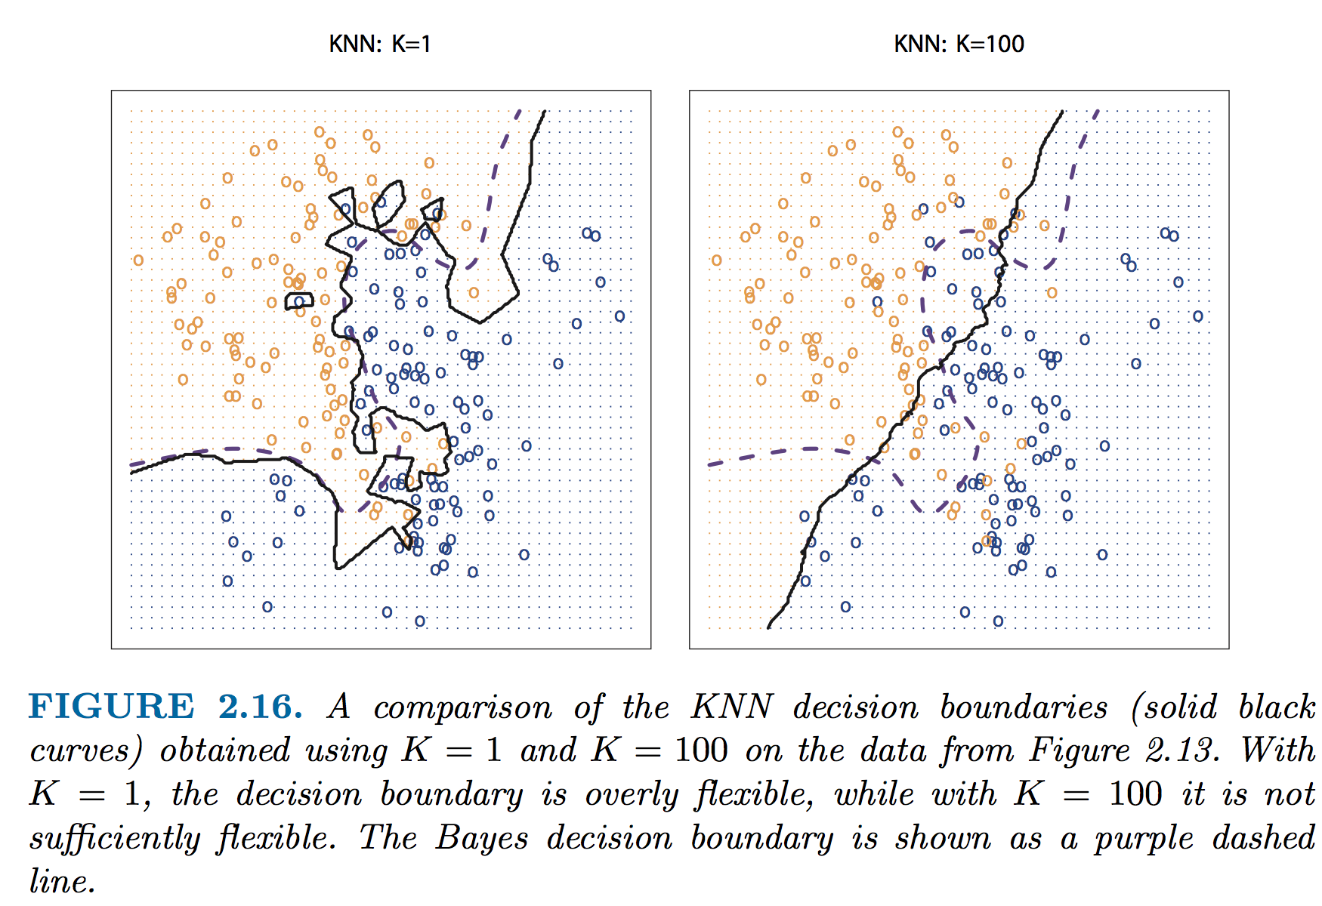
K too big or too small: noise and accuracy
Notes:
Why does this matter? Look @ islands w/K=1 and effect of noise! – look @ loss of flexibility w/ K=100 and loss of accuracy

Slide 23
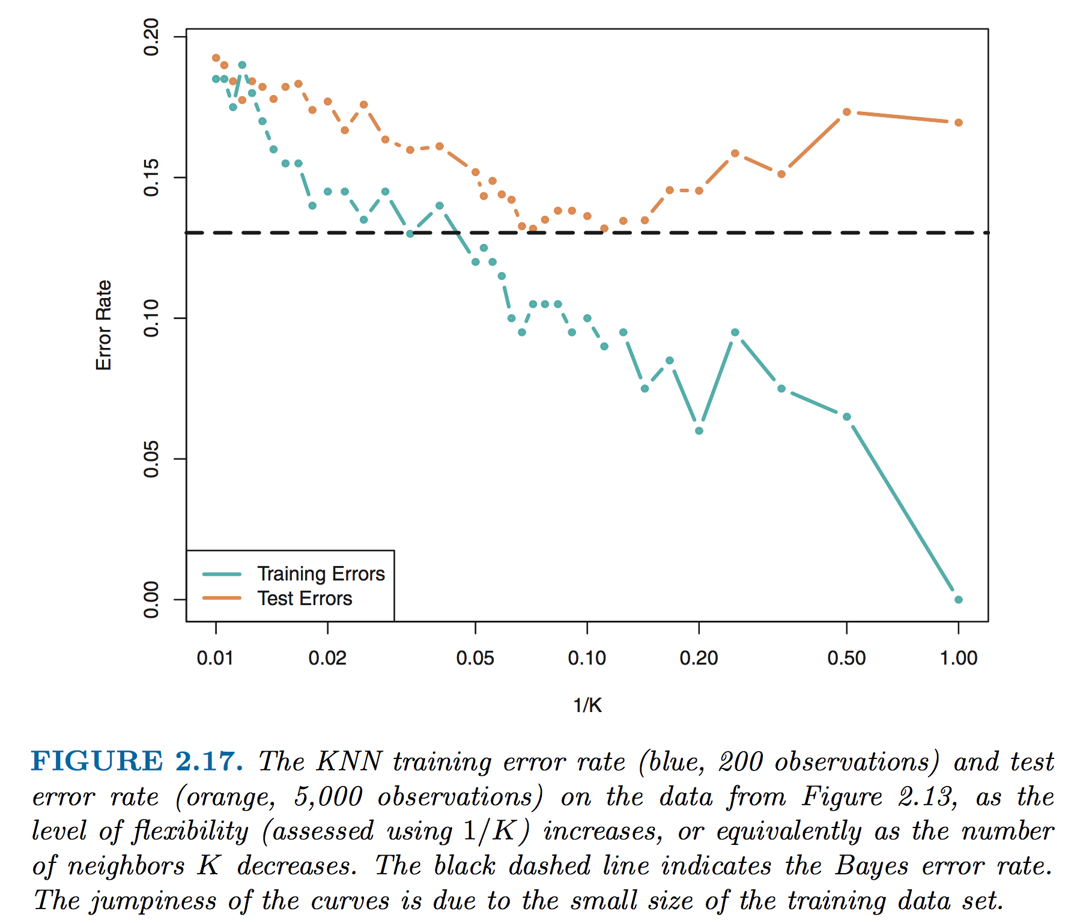
Effect of K on accuracy
Notes:
In terms of overfitting, there is an ideal number of K that minimizes the error rate.

Slide 24
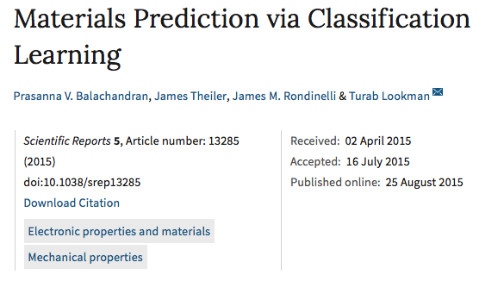
Practice with the KNN!
Lets get our hands dirty
The example data we are using come from the paper below
Much of the code comes from the scikit-learn KNN tutorial (http://scikit-learn.org/stable/tutorial/statistical_inference/supervised_learning.html)

Slide 25
With one partner (14x2!)
Get the notebook from the syllabus
Partner up
Hack away!

